Slide 1

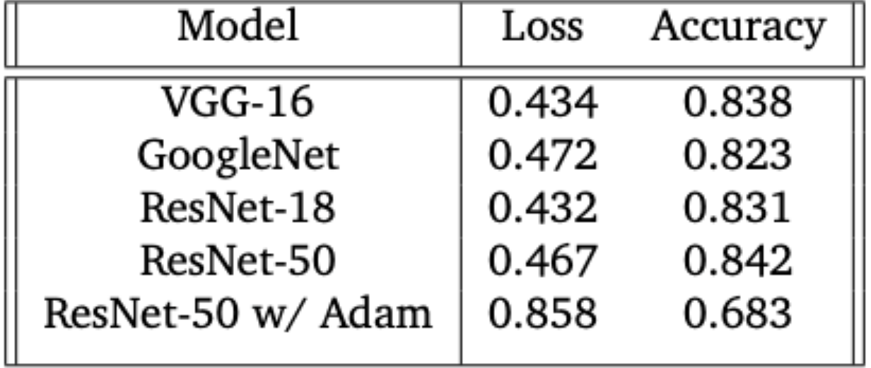
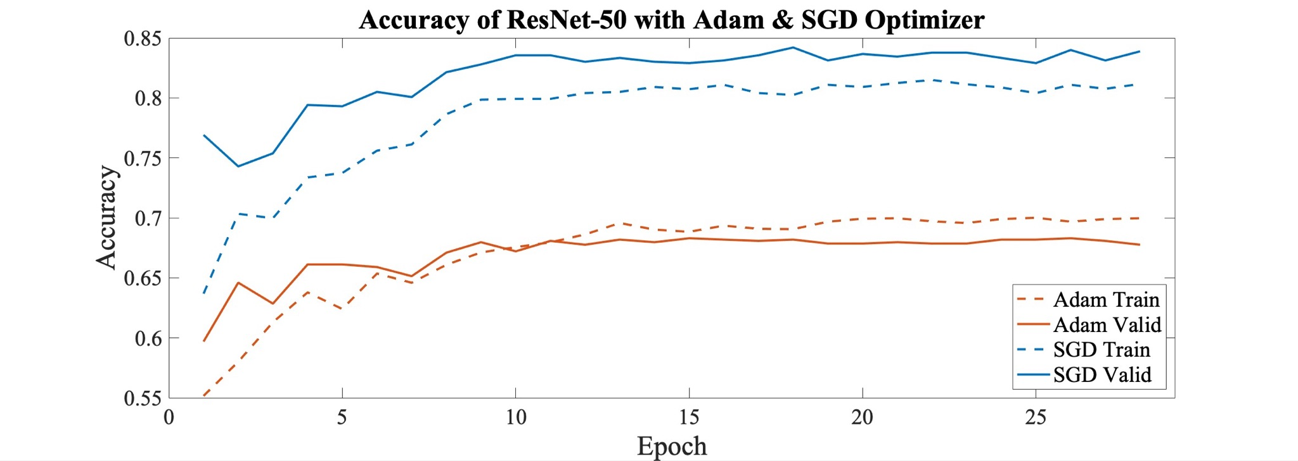
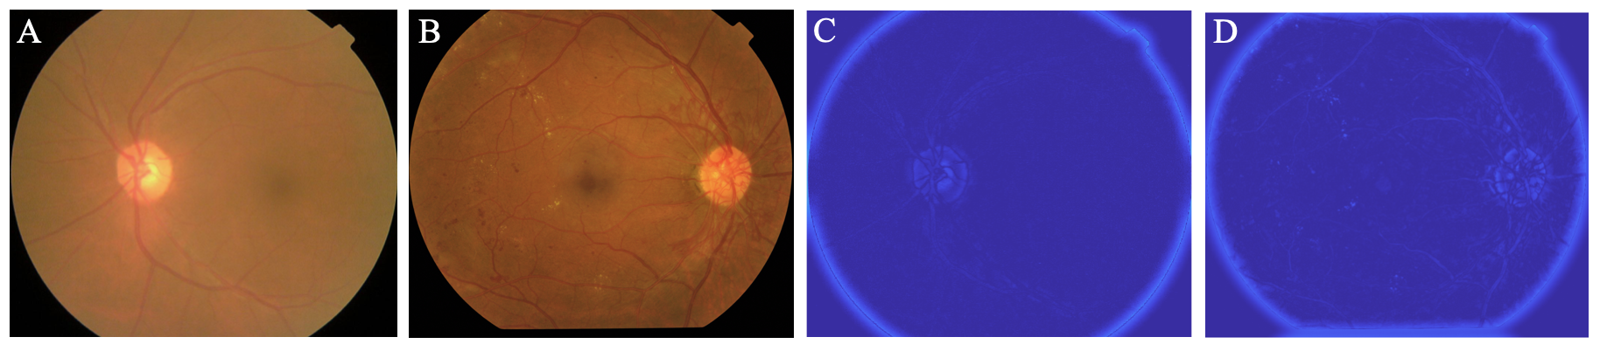
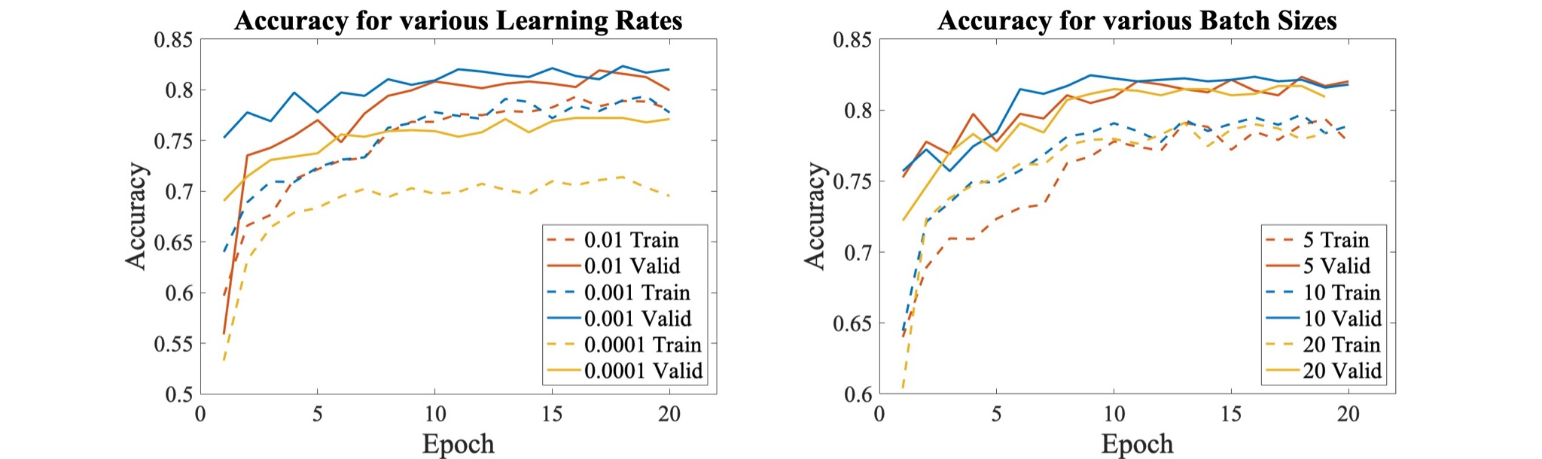
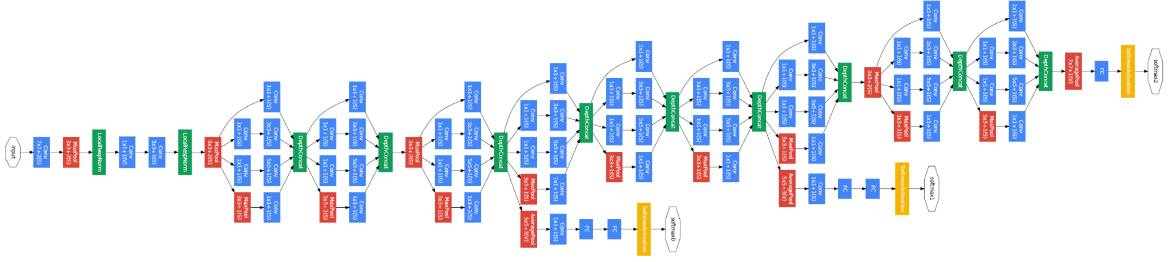
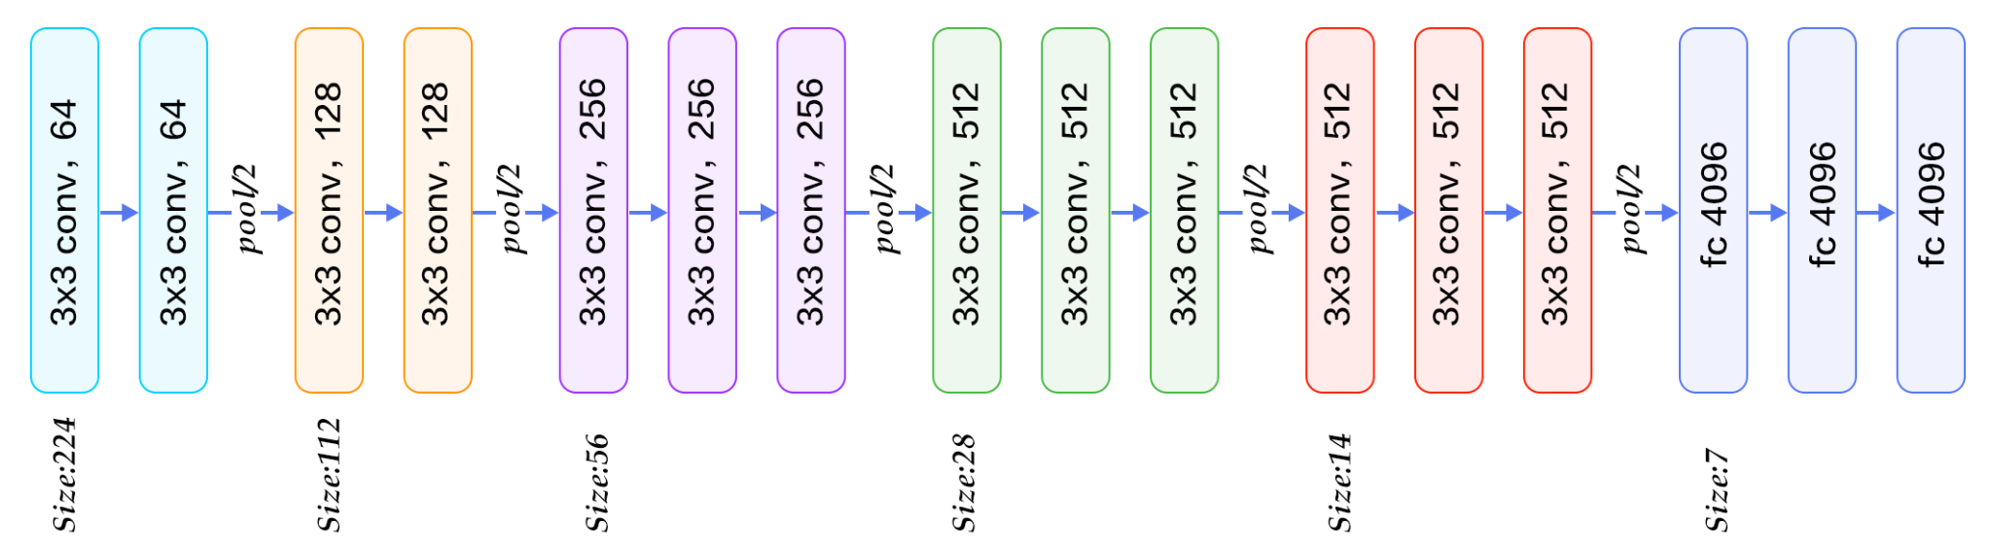
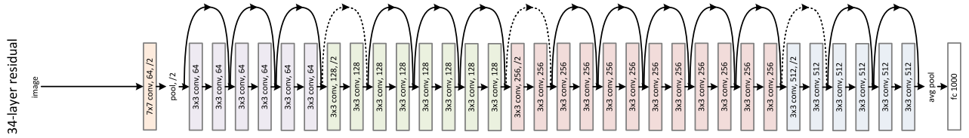
Deep Learning to Automate Diagnosis of Diabetic Retinopathy
Alaina Lim, Amrit Singh, Honghao Zhen
alainasl@stanford.edu, honghao_zhen@stanford.edu, amrit2@stanford.edu
Stanford University Department of Computer Science, Stanford University Department of Mechanical Engineering
Background and Significance
Results
Diabetic retinopathy (DR) is a common and dangerous complication of diabetes, with approximately 1 in 3 diabetes patients contracting DR during their lifetime. DR and the damage caused by it is permanent, but treatment can help to maintain one’s vision and prevent further vision loss. Thus, early detection and treatment is imperative to those suffering from diabetic retinopathy. The current screening process for DR is rather inaccessible and time-consuming; it requires a well-trained, licensed ophthalmologist, costs hundreds of dollars out of pocket, and is prone to misdiagnosis. We will take an input of an eye with ranging severity of diabetic retinopathy and will output the predicted diagnosis.
The modified ResNet-50 with SGD optimizer and weights transferred from the Resnet-18 model performed the best after careful optimization of learning rate and batch size. Interestingly, the SGD optimizer performed 16% better than the popular Adam optimizer without any difference in training time. We attribute this to SGD’s ability to better generalize and locate a global minimum.
FIG 1 (A) Class 0 original image (B) Class 4 original image (C) Class 0 image after Fourier transform (D) Class 4 image after Fourier transform. Nodules and lesions on the reina are accentuated in the Class 4 transformed image.
Discussion
This project explores the effectiveness of different neural net architectures at classifying diabetic retinopathy images. Although our best model was only able to classify retinas with 84% accuracy, it does correctly diagnose 97% of DR-positive images, thereby validating the use of CNNs as a viable means of flagging potential DR cases for further evaluation by a trained physician.
We observed the importance of carefully tuning hyperparameters such as the learning rate and batch size, while taking advantage of transfer learning to obtain network weights while training on a simpler model. Subsequently porting those weights over to our full model, we minimized the risk of overfitting, resulting in a model that generalizes better when exposed to unseen data.
Data and Features
The dataset used was APTOS 2019 Blindness Detection by Kaggle. The images of retinas provided are colored, labeled 0 (no symptoms) to 4 (severe DR), and with varying brightness, focus, and magnification. DR is characterized by the presence of lesions, nodules, abnormal vascular structures etc. on the retina, which our Convolutional Neural Net would identify. For select training examples, we used a Fourier transform and high-pass filter to accentuate the nodules and lesions while suppressing non-DR features, thereby augmenting our training data.
Models
A convolutional Neural Network is the most suitable classification tool due to its flexibility and ability to capture high degrees of variance. We implemented 3 renown architectures:
VGG-16: Introduced by Oxford’s Visual Geometry Group in 2014, VGG improves upon AlexNet with its increase in the number of kernel-sized filters
GoogleNet: Developed by Google in 2014, GoogleNet uses 1x1 convolutions to minimize the number of parameters and increase depth as well as inception modules.
ResNet-50: Proposed by Microsoft Research in 2015, skip connections connect layers to other layers further in architecture, skipping some layers creating residual blocks.
Next Steps
2b
2a
There is much more to improve on in terms of DR diagnosis; we would be interested in implementing newer, more advanced architectures such as Inception V-3 that could possibly learn the features of DR better. In addition, we want to augment the data more and further refine the Fourier transformed images for a wider training set of data.
2c
References
FIG 2 Overview of VGG (a)[4], GoogleNet (b)[3], and ResNet (c)[1] architectures
[1] He, Kaiming et al. (2015). “Deep Residual Learning for Image Recognition”. In:doi:10.48550/ARXIV.1512.03385.url:https://arxiv.org/abs/1512.03385.
[2]National Eye Institute (2022). “Diabetic Retinopathy”. In: National Institute of Health. url :https://www.nei.nih.gov/learn-about-eye-health/eye-conditions-and-diseases/diabetic-retinopathy
[3] Szegedy, Christian et al. (2014). “Going Deeper with Convolutions”. In:doi:10 . 48550 / ARXIV . 1409 . 4842.url:https://arxiv.org/abs/1409.4842.
[4] Simonyan, Karen, Andrew Zisserman (2014). “Very Deep Convolutional Networks for Large-Scale Image Recognition”.In:2019 Amity International Conference on Artificial Intelligence (AICAI).url: https://doi.org/10.48550/arXiv.1409.1556.
Notes:
https://suncatcherstudio.com/block-poster/

